Slide 1
Feature detection, extraction, matching

Slide 2
Features
A vectorial representation of objects/patterns/areas in an image
Features characterize color, shape, texture, etc.
A good feature is robust
Feature detection – find points of interests in the image: e.g.: corners
Feature extraction – based on keypoints or features, give a numerical representation of the pixels-of-interest and their neighborhood.
Can be done globally at image level
Or divide image in patches
Use keypoints location as guide for localizing a neigborhood

Slide 3
Feature Detection
A good feature is robust to changes in illumination, geometry (translation, rotation), viewpoint and scale.
Algorithms:
Harris Corner Detection – scale-sensitive
Scale Invariant Feature Transformation (SIFT) – multiscale capabilities
There are many SIFT extensions: SURF, BRISK, ORB, KAZE…

Slide 4
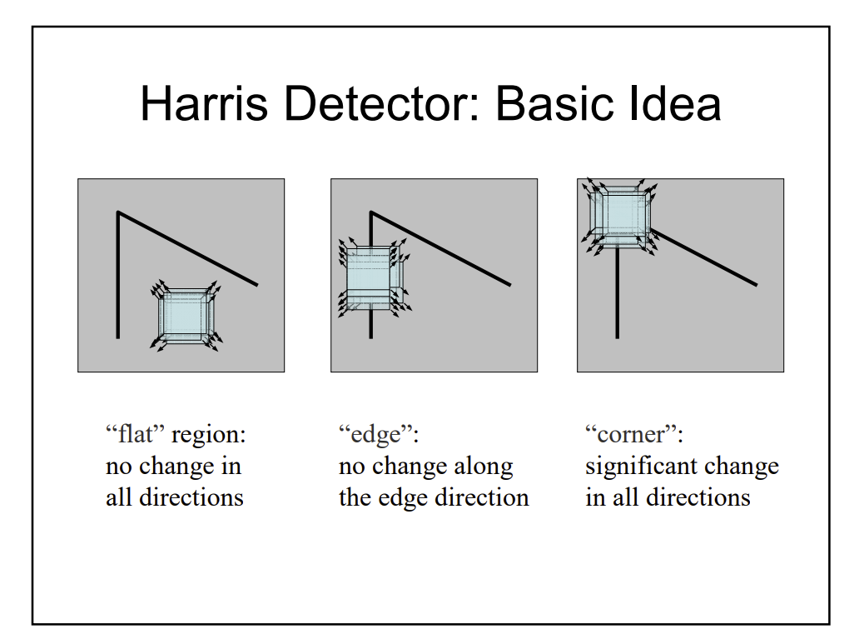
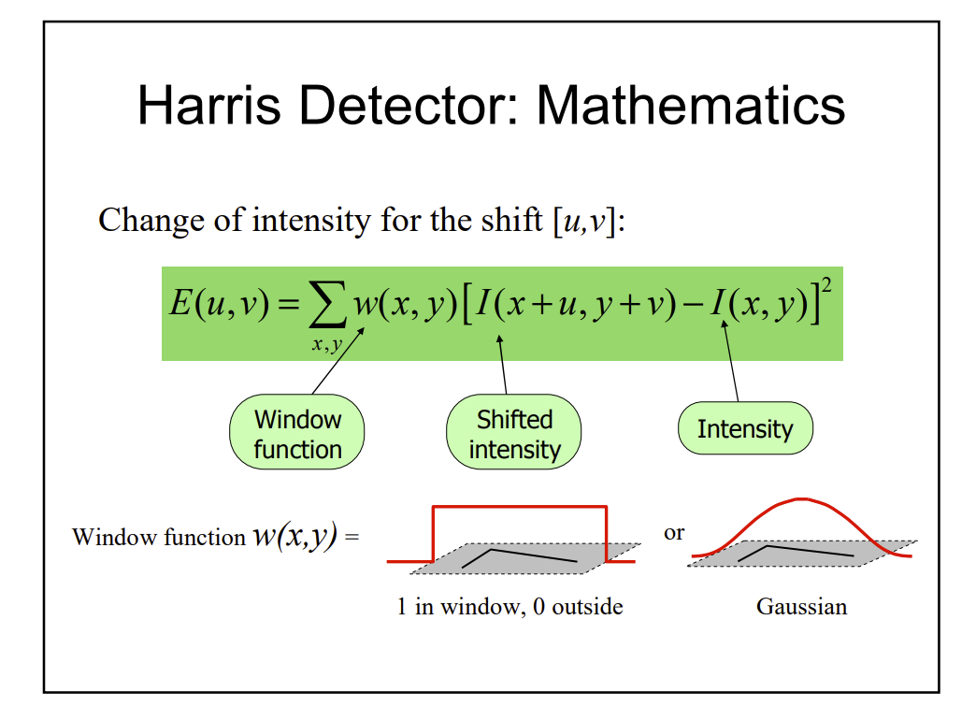
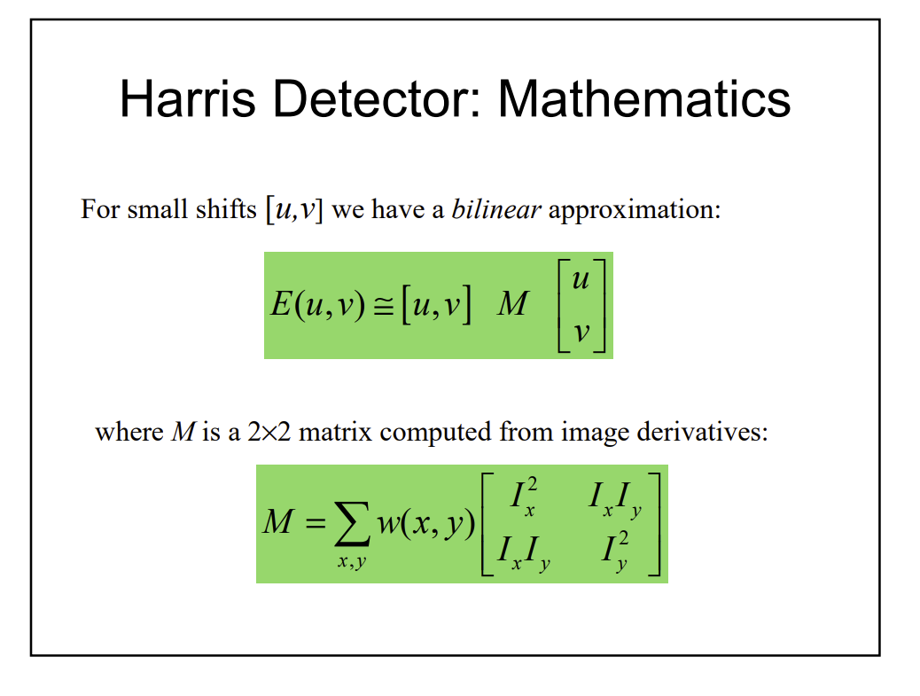
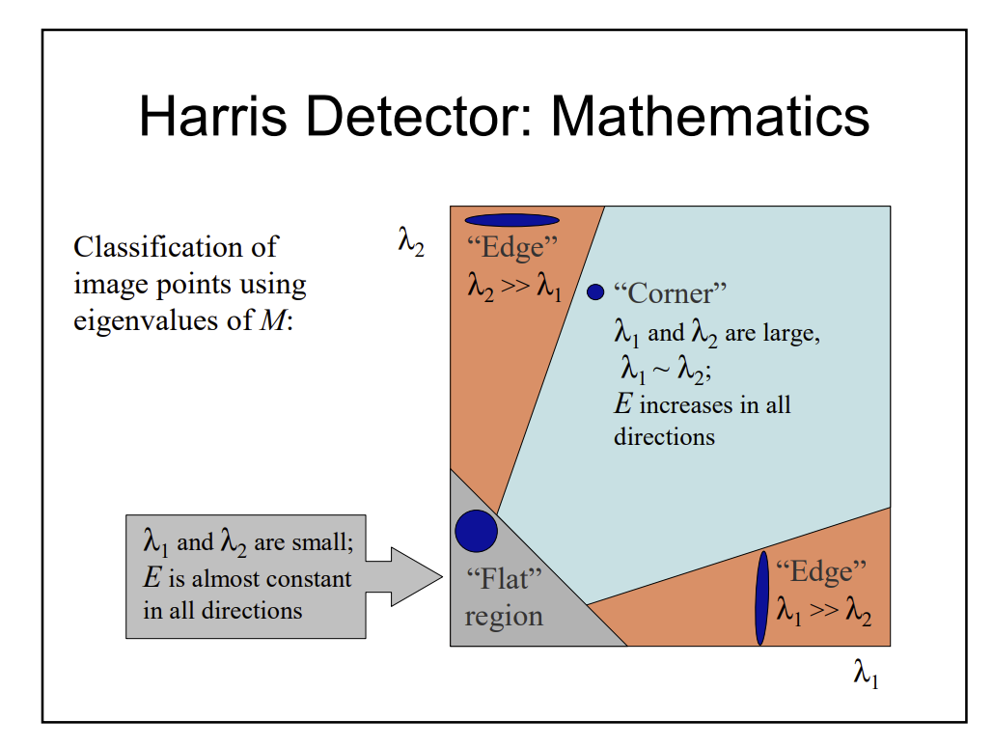

Slide 5
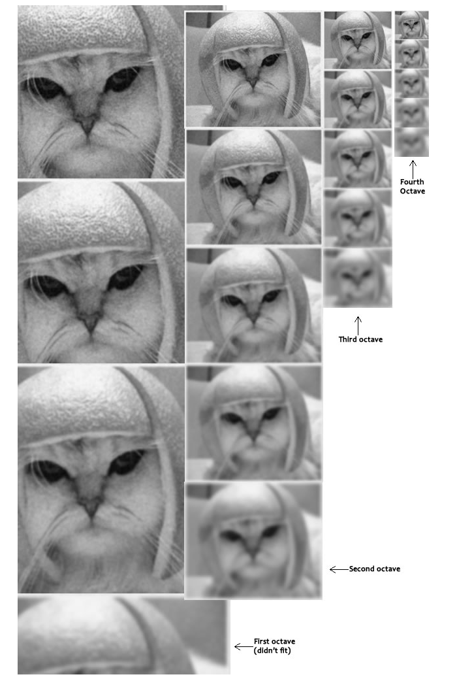
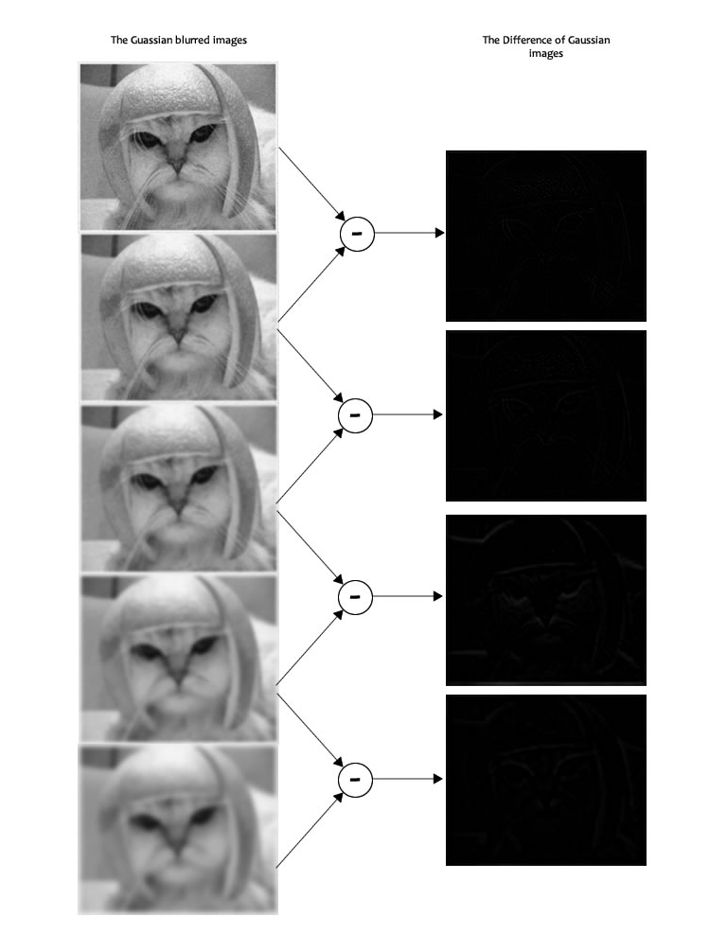
SIFT operates in a scale space

Slide 6
Feature extraction
Compute a numerical representation around important points of interest and their neighborhood: pixel intensity value, gradient orientation, magnitude, histogram, etc
Most of the feature detection techniques (SURF, ORB, etc.) have their own way of computing a descriptor.
An important feature extraction technique is Histogram of Oriented Gradients.

Slide 7
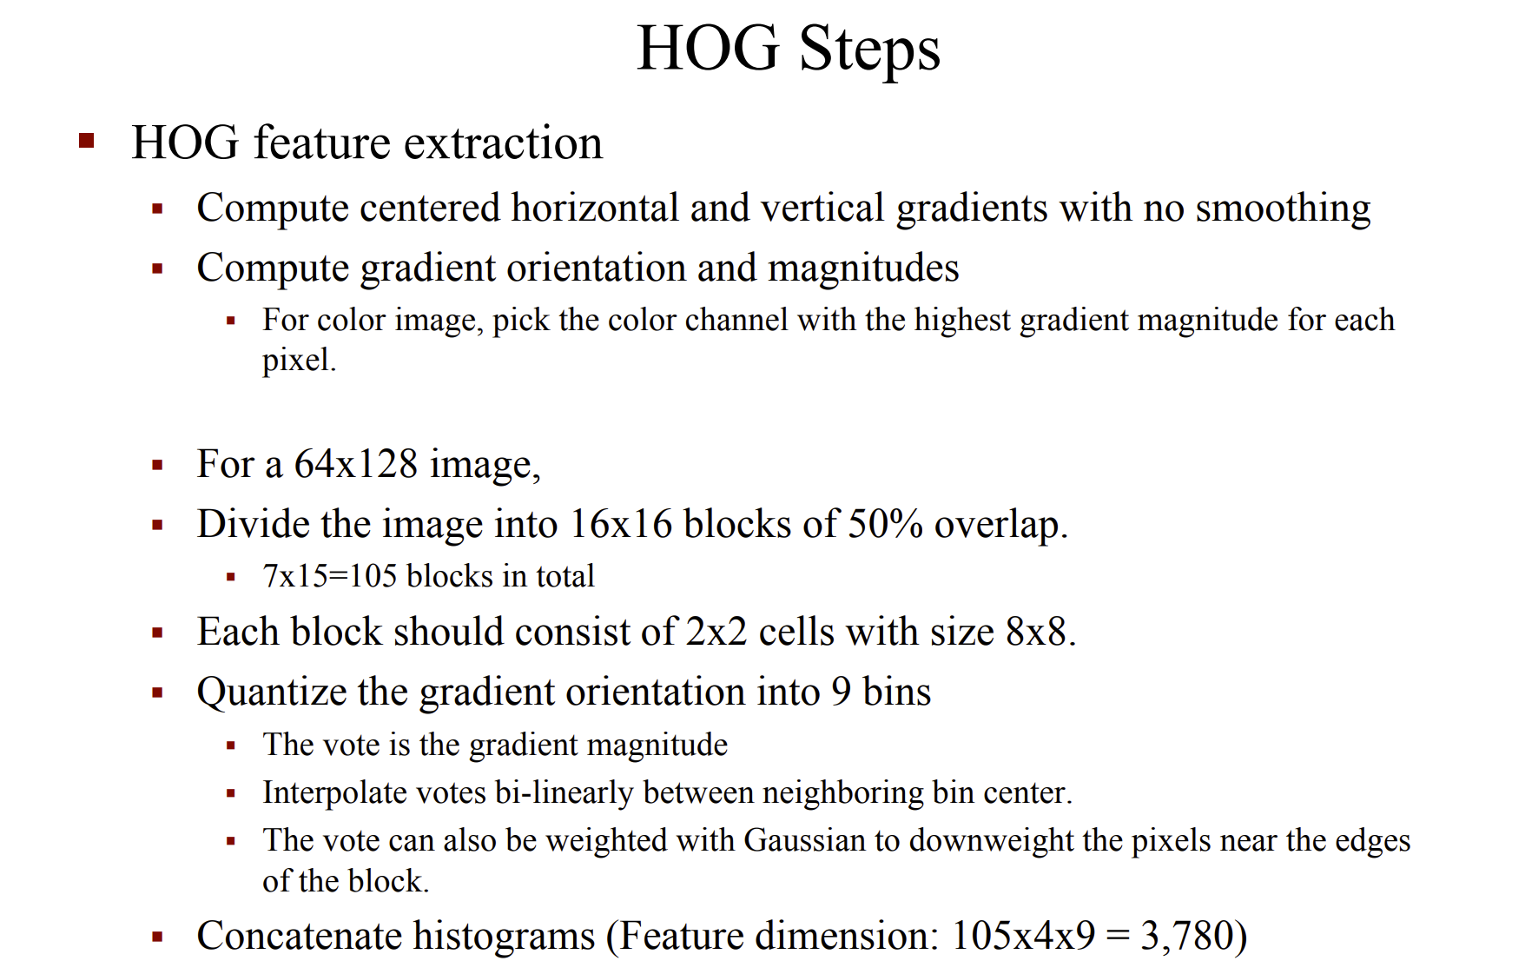
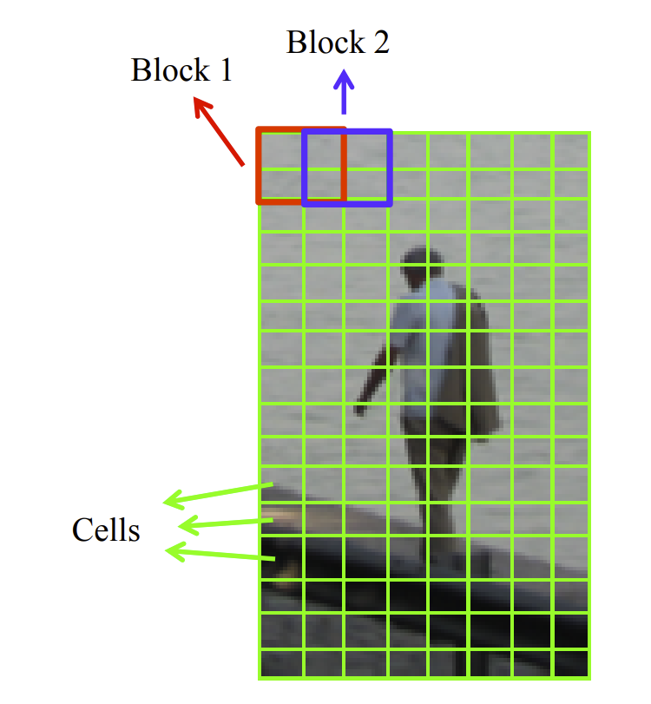
Histogram of Oriented Gradients
Proposed by Dalal and Triggs in 2005

Slide 8
Feature matching
Given common objects in two scenes, map the correspondences between the same object.
Application: image registration, image stitching (panoramic photos), template matching.

Slide 9
Classification
Uses features as well.
A classifier is a “function” that separates between features based on their similarity or dissimilarity.
To be done next week.

